Slide 1
Analyzing the ACM Citation Network
Justin Orr
CSC 570- Big Data Analysis
11/26/2016

Slide 2
Overview
What is the ACM Citation Network?
Setting up the Scala Project
Building the Citation Network using Spark
Performing Graph Analytics on the ACM Citation Network
Visualizing the In-Degree Distribution
Implementing a weighted page rank algorithm
Results & Conclusions

Slide 3
What is the ACM Citation Network?
A collection of citation data which can be used for studying influence in the citation network, finding the most influential papers, topic modeling, and other research projects.
Consists of 2,381,688 papers and 10,476,564 citation relationships
Each “block” of data comes in a general format:
#* Paper Title
#@ Authors
#t Year
#c Publication Venue
#index <id of this paper>
#% ids of references of this paper (can be multiple lines for each reference)
#! Abstract

Slide 4
Setting up the Scala Project
In order to be able to read in the “blocks” of data, the spark configuration will require a different default record delimiter.
This will allow every initial rdd element to be a chunk of paper data, unique to that paper.
Imports:
Main Method:
import org.apache.spark.sql.SparkSession
import org.apache.hadoop.conf._
import org.apache.hadoop.io._
import org.apache.hadoop.mapreduce.lib.input._
import scala.util.matching.Regex
import scala.util.hashing.MurmurHash3
import spark.implicits._;
@transient val config = new Configuration
config.set("textinputformat.record.delimiter", "#*")

Slide 5
Reading in the Citation Network Data
The citation data was uploaded to a Hadoop File System(HDFS) on a local cluster.
This data was accessible at:
Since the project has been preconfigured to handle the special dataset, all that must be done is read the data in as RDD Records and filter out any empty records:
"hdfs://CSC570-BD-HMF12:9000/hadoop-user/data/citation-acm-v8.txt”
val inputRDD = sc.newAPIHadoopFile(<input-file-path>, classOf[TextInputFormat], classOf[LongWritable], classOf[Text], config)
val inputRDDMapFilter = inputRDD.map{case(key,value)=>value.toString}.filter(value=>value.length!=0)

Slide 6
Building the Citation Network: Retrieving the Indexes
Now that the dataset is in an RDD format, there is a requirement to trim off information that is not needed.
This includes data that isn’t necessary, such as abstract and trademark fields, but also data that could be hindering such as the ‘#index’ and ‘#%’ prefixes that appear prior to the paper index and paper references, respectively.
To handle the index issue, a function is needed that can be passed the paper ‘chunk’ and use a Regex statement to extract the index information, as well as remove the ‘#index’ prefix.
def getIndexKey(line: String): String= {
val pattern = new Regex("#index[a-zA-Z0-9]*");
val found = pattern.findFirstIn(line).getOrElse("Null");
if(found!="Null") {
val phrase = new Regex("#index");
return phrase.replaceFirstIn(found, "") }
else return found;
}

Slide 7
Building the Citation Network: Retrieving the References
To handle the references issue, a function is needed that can be passed the paper ‘chunk’ and use a Regex statement to extract each reference (if one exists), remove the ‘#%’ prefix, and return a comma-delimited list of the reference id’s.
def getReferences(line: String): String= {
val pattern = new Regex("#%[a-zA-Z0-9]*");
val found = pattern.findAllIn(line).toList;
if(found.length > 0) {
val refList = for(ref <- found) yield {ref.replace("#%","")};
return refList.mkString(",") }
else return "Null“;
}

Slide 8
Building the Citation Network: Parsing the Data
Now that the extraction methods are created, there is one more addition that is necessary to help format and label each piece of information:
This class “appends” a field name to the data that is passed to it. This allows for easier referencing and joining in later steps.
All the prerequisites to parsing the data are setup. Now the data ‘chunks’ can be mapped to the Paper class with help from the extraction methods.
Since we chose to implement the Paper class, storing the ‘paperData’ dataset in an Apache Hive view is becomes easy:
case class Paper(paper_id:String, paper_title:String, paper_references:String)
val paperData = inputRDDMapFilter.map{ case(chunk) =>
Paper(getIndexKey(chunk), chunk.split('#')(0).trim, getReferences(chunk))}
val papersView = paperData.toDF.createOrReplaceTempView("papersView")

Slide 9
Building the Citation Graph
The next step is to use the Paper’s stored in the ‘papersView’ to build the citation graph. The citation graph is the one-to-one link of each paper to each of its references.
To do so, another class will be utilized:
Then, all papers that have one or more references will be selected from the View:
And each paper will be mapped, one-to-one, to its references:
case class PaperReference(paper_id:String, paper_reference:String)
val pairData = spark.sql("SELECT paper_id, paper_references FROM papersView WHERE NOT paper_references='Null'")
val flatData = pairData.rdd.map(row => (row(0).toString,row(1).toString)) .flatMapValues(refs=>refs.split(',')) .map(pair=>PaperReference(pair._1,pair._2))

Slide 10
Citation Graph: Example
At this point, ‘flatData’ contains the citation graph.
This is a small portion of ‘flatData’:
5390879920f70186a0d422a5 5390877920f70186a0d2ce74
5390879920f70186a0d42380 5390877920f70186a0d2cdc1
5390879920f70186a0d42380 5390877f20f70186a0d30e07
5390879920f70186a0d42380 5390878a20f70186a0d384d2
5390879920f70186a0d42380 5390879220f70186a0d3c3c0
5390879920f70186a0d42380 539087e120f70186a0d66016
5390879920f70186a0d42380 539087f820f70186a0d72d26
5390879920f70186a0d42380 539087f920f70186a0d73335
5390879920f70186a0d4237f 5390877f20f70186a0d31044
5390879920f70186a0d4237f 5390879220f70186a0d3c434
5390879920f70186a0d4237f 539087e120f70186a0d66016

Slide 11
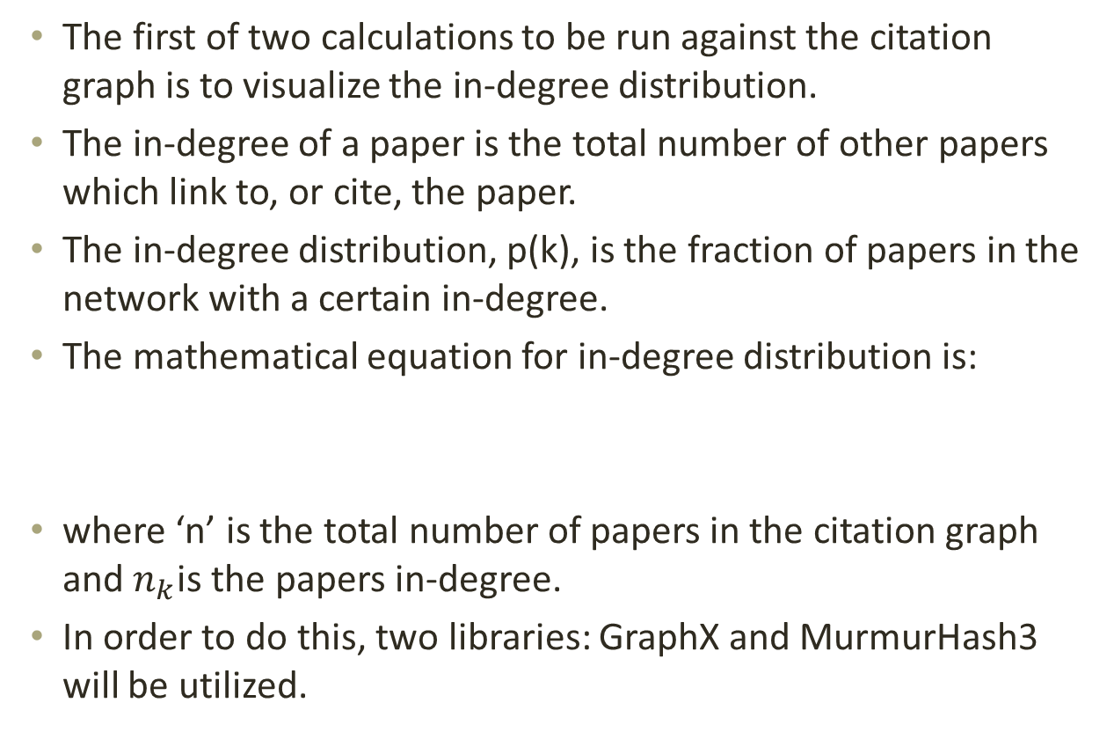
Performing Graph Analytics: Visualizing the In-Degree Distribution
The first of two calculations to be run against the citation graph is to visualize the in-degree distribution.
The in-degree of a paper is the total number of other papers which link to, or cite, the paper.
The in-degree distribution, p(k), is the fraction of papers in the network with a certain in-degree.
The mathematical equation for in-degree distribution is:
where ‘n’ is the total number of papers in the citation graph and $n_{k}$is the papers in-degree.
In order to do this, two libraries: GraphX and MurmurHash3 will be utilized.
P(k) = $\frac{n_{k}}{n}$

Slide 12
Spark GraphX and MurmurHash3
GraphX is an Apache Spark library which allows for the creation of a graph when given a list of edges.
Edges, in this case, are links from one paper to another. This is exactly what the citation graph is.
One issue: GraphX requires that each edge be of a Long Datatype.
Since the paper_id’s are strings that cannot be directly converted to Long values, they must instead be converted to a unique, but repeated able Long value via hashing.
MurmurHash3 is a Scala library that implements a well-distributed, non-cryptographic hash method called ‘stringHash(String)’
This returns the hash code value of a given string as an Integer, which can easily be converted to a Long Datatype.

Slide 13
Creating the GraphX graph
Utilizing these two libraries, the GraphX graph can be created:
Now that the graph is created, the total number of papers (vertices) can be grabbed for the next step.
val hashedData = flatData.map{ case PaperReference(index, reference) => (MurmurHash3.stringHash(index).toLong, MurmurHash3.stringHash(reference).toLong) }
val graph = Graph.fromEdgeTuples(hashedData, null)
val vertCount = graph.numVertices

Slide 14
In-degree sums and in-degree distribution
For the In-degree distribution equation, the necessary components are the total number of papers (the stored value ‘vertCount’ ), the list of all in-degrees (a default member of our ‘graph’ object), and the number of times each in-degree exists.
Therefore, all that needs to be calculated is the number of times each in-degree appears. This can be achieved by mapping each in-degree to a key-value pair of (in-degree, 1) and combining on the new key:
Then it is just a matter of calculating the formula on each of the sums:
val indegreeSums = graph.inDegrees.map{case(node,indegree)=>(indegree, 1)} .reduceByKey((v1,v2)=>v1+v2)
val indegreeDist = indegreeSums.map{ case(indegree,sum)=>(indegree,sum.toDouble/vertCount.toDouble)}

Slide 15
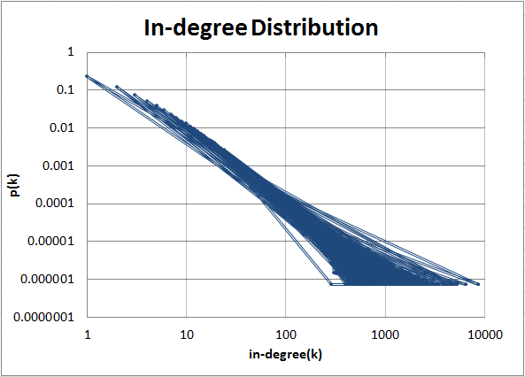
Results
This calculation results in the overall in-degree distribution for every paper in the citation graph:

Slide 16
Performing Graph Analytics: Implementing a weighted page rank algorithm
The last calculation to be run against the citation graph is to implement a weighted page rank algorithm.
This algorithm will be used to find the top ten most influential papers in the network.
The weighted page rank algorithm measures the importance of a page by the importance of other pages that are linked to it.
It is an extension of the standard page rank algorithm, which takes into account the importance of in-links and out-links of a page and distributes rank scores based on the popularity of a page.

Slide 17
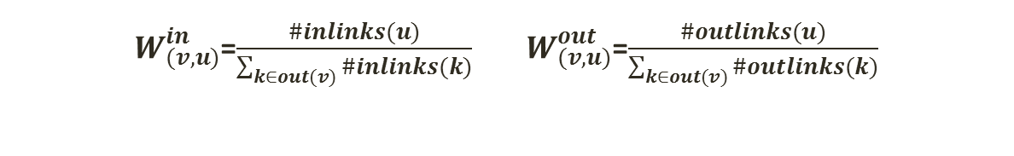
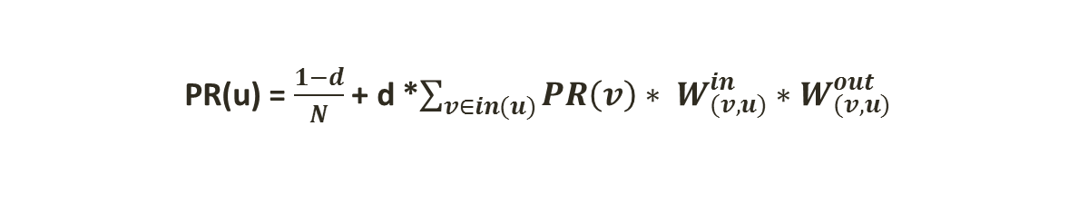
The Page Rank Algorithm
The weighted page rank, PR(u) of a paper ‘u’ is calculated as:
d is a constant value set at .85
N is the total number of papers in the citation network
in(u) is the set of all nodes which link to node u
W^{in} is the in-weight of link(v,u)
W^{out} is the out-weight of link(v,u)
W^{in} and W^{out} are calculated by:
PR(u) = $\frac{1−d}{N}$ + d *$\sum_{v∈in(u)}{PR\left(v\right)∗ W_{(v,u)}^{in}}∗W_{(v,u)}^{out}$
$W_{(v,u)}^{in}$=$\frac{\#inlinks(u)}{\sum_{k∈out(v)}{\#inlinks(k)}}$ $W_{(v,u)}^{out}$=$\frac{\#outlinks(u)}{\sum_{k∈out(v)}{\#outlinks(k)}}$

Slide 18
Page Rank Algorithm: Numerators
To start, it is necessary to calculate the in-links and out-links for each paper.
The in-links can be calculated by using the citation graph from earlier and mapping each Paper Reference’s paper-reference value to the value 1.
The key-value pair will then be mapped to a class to help label the data:
In order to calculate the out-links, the same thing is done except with the paper-id instead of the paper-reference:
A dataset can then be created by joining the citation graph with both ‘wIn’ and ‘wOut’ calculations to store the numerators:
case class weightIn(wIn_id:String, _wIn:Int)
val wIn = flatData.map{ case PaperReference(id,ref)=>(ref,1)} .reduceByKey((v1,v2)=>v1+v2).map{case(x,y)=>weightIn(x,y)}
case class weightOut(wOut_id:String, _wOut:Int)
val wOut = flatData.map{case PaperReference(id,ref)=>(id,1)}
.reduceByKey((v1,v2)=>v1+v2).map{case(x,y)=>weightOut(x,y)}
val topWeightsJoin = flatData.toDF.as("links")
.join(wIn.toDF.as("win"),$"links.paper_reference"===$"win.wIn_id") .join(wOut.toDF.as("wout"),$"links.paper_reference"===$"wout.wOut_id") .select($"paper_id", $"paper_reference", $"_wIn", $"_wOut")

Slide 19
Page Rank Algorithm: Denominators
Now that the numerators are known, the denominators must be found in order to calculate the weight factors for each link.
To calculate this, the ‘topWeightsJoin’ dataset that was just created will be used.
The denominator for In-Weight is shown to be the summation of in-links to a given paper. That means if ‘topWeightsJoin’ is reduced by the paper-id and all values are summed together, the denominator will be the total of that summation. The same applies for Out-Weight as well.
val botIn = topWeightsJoin.rdd.map(row=>(row.getAs[String]("paper_id"), row.getAs[Int]("_wIn"))).reduceByKey((v1,v2)=>v1+v2).map{case(x,y)=>weightIn(x,y)}
val botOut = topWeightsJoin.rdd.map(row=>(row.getAs[String]("paper_id"), row.getAs[Int]("_wOut"))).reduceByKey((v1,v2)=>v1+v2).map{case(x,y)=>weightOut(x,y)}

Slide 20
Page Rank Algorithm: Weight Factors
Now that the denominators are known, it is just a matter of joining the ‘topWeightsJoin’ dataset against the paper-id value.
This allows a selection to be made that divides each numerator by the denominator.
Also since from this point on the factors are never used alone, the two values can be multiplied together to get a single ‘Weight Factor’ for the remaining calculations:
val weightCalcs = topWeightsJoin.as("tw").join(botIn.toDF.as("bIn"),$"tw.paper_id"===$"bIn.wIn_id") .join(botOut.toDF.as("bOut"), $"tw.paper_id"===$"bOut.wOut_id") .select($"paper_id", $"paper_reference", (($"tw._wIn"/$"bIn._wIn")*($"tw._wOut"/$"bOut._wOut")).alias("weight"))

Slide 21
Page Rank Algorithm: Calculating initial page ranks
All of the setup work to calculate the page ranks is now complete.
The next step is to map the ‘weightCalcs dataset into a key-tuple pair, group by the paper-id so that the iterative page ranks can be calculated.
Also, at this point each of the initial page ranks will be mapped. These are simply 1/N, where N is the total number of papers.
val weights = weightCalcs.rdd.map(row=>(row.getAs[String]("paper_id"), (row.getAs[String]("paper_reference"),row.getAs[Double]("weight"))))
val links = weights.groupByKey().persist()
var ranks = links.map{case (id,links)=>(id, 1/vertCount.toDouble)}

Slide 22
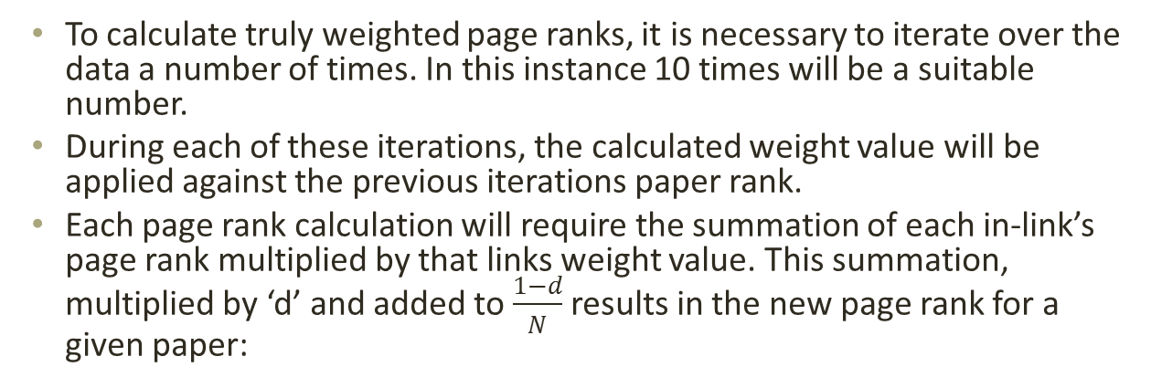
Page Rank Algorithm: Calculating page ranks over 10 iterations
To calculate truly weighted page ranks, it is necessary to iterate over the data a number of times. In this instance 10 times will be a suitable number.
During each of these iterations, the calculated weight value will be applied against the previous iterations paper rank.
Each page rank calculation will require the summation of each in-link’s page rank multiplied by that links weight value. This summation, multiplied by ‘d’ and added to $\frac{1−d}{N}$ results in the new page rank for a given paper:
for(x <- 1 to 10){
val contribs = links.join(ranks).flatMap{case(id,(links,rank))=> getWeightedRanks(links, rank)}
ranks = contribs.reduceByKey((c1,c2)=>c1+c2).map{case(id,sum)=>(id, sum * .85 + .15/vertCount.toDouble)}
}
def getWeightedRanks(links:Iterable[(String,Double)],rank:Double):Iterable[(String,Double)]={
for(l <-links) yield (l._1, l._2 * rank)
}

Slide 23
Retrieving the Top Ten
Two steps remain:
Select the Top Ten page ranks from the dataset ‘ranks’
Join this dataset with earlier data to retrieve the desired output
In order to select the top ten page ranks, the ‘ranks’ dataset needs to be sorted in descending order by the page rank value:
Then, these ten values are joined with the initial ‘paperData’ dataset to retrieve each paper’s title and with the ‘wIn’ dataset to retrieve the number of in-links each paper had:
val topTen = ranks.toDF.select($"_1", $"_2").sort($"_2".desc).limit(10)
val answer = topTen.as("tt").join(paperData.toDF.as("papers"),$"tt._1"===$"papers.paper_id") .join(wIn.toDF.as("inlinks"),$"papers.paper_id"===$"inlinks.wIn_id") .select($"papers.paper_title", $"inlinks._wIn", $"tt._2").sort($"tt._2".desc)

Slide 24
Results
This results in the ‘answer’ data set containing the Top Ten papers in the desired format of:
Paper Title Number of Citations (In-Links) Page Rank
Singularity Theory and Phantom Edges in Scale Space 15 5.547660800419622E-5
A method for obtaining digital signatures and public-key cryptosystems 2223 3.560501257657747E-5
Chunking in Soar: The Anatomy of a General Learning Mechanism 86 2.931864129156816E-5
Authenticating Edges Produced by Zero-Crossing Algorithms 26 2.6347333246707292E-5
Explanation-Based Generalization: A Unifying View 223 2.4545526401968333E-5
Graph-Based Algorithms for Boolean Function Manipulation 2016 2.2814733783448177E-5
The complexity of theorem-proving procedures 837 1.959916725929189E-5
Learning state space trajectories in recurrent neural networks 23 1.6470071157510616E-5
Data clustering: a review 1701 1.5063445065046652E-5
The Anatomy of the Grid: Enabling Scalable Virtual Organizations 1348 1.5030485991018525E-5

Slide 25
References
[1] https://aminer.org/billboard/citation, Yutao. "AMiner." AMiner. Web. 28 Nov. 2016.
[2] W. Xing and A. Ghorbani, "Weighted PageRank algorithm," Communication Networks and Services Research, 2004. Proceedings. Second Annual Conference on, 2004, pp. 305-314.
[3] http://www.scala-lang.org/api/2.12.0-M4/scala/util/hashing/MurmurHash3, Scala Standard Library 2.12.0-M4 - Scala.util.hashing.MurmurHash3. Web. 28 Nov. 2016.

